Slide 1
Category review: Chips
June 2020
Retail Analytics
Brand note: If client logo is not required, use alternate title page layout right click slide thumbnail > Layout > Title

Slide 2
Notes:
To view Privacy video explaining how important data privacy is to Quantium, please click here: https://www.youtube.com/watch?v=Zq1QDAkoRzU
or here Q:\Company Reference\Brand & Design\Brand videos\Q Privacy.mp4
At Quantium, we believe that data is the behavioural footprint of humanity and that it has to be treated with the utmost care and responsibility.
Histories, attitudes, indeed lives are stored within it in ways that aren’t always apparent – and that’s what makes its potential so powerful.
To work with it responsibly, sensitively, we set ourselves the highest data privacy protection and governance standards.
We have spent 17 years perfecting privacy-by-design and secure-by-design principles. Central to this is not holding any personally identifiable information about people –
we neither receive it, and put the necessary protections in place to be unable to decipher it.
Every aspect of handling data is safeguarded: from its de-identification, to its encryption – data security is paramount and of the highest grade.
We pride ourselves on gaining the trust of iconic organisations around the world through years of securely working with their data,
and in turn the trust that builds with their stakeholders.

Slide 3
.
Executive summary
Budget Older Families drive highest total sales despite having fewer customers, indicating high spending power per customer in this segment.
Mainstream Young Singles/Couples represent the largest customer base but with lower individual spend, presenting significant growth opportunity through targeted strategies.
Mainstream customers pay premium prices - statistical testing confirms they pay significantly higher unit prices compared to Budget segments.
Strong brand affinity patterns identified in target segments, with specific chip brands showing clear preference among Mainstream Young Singles/Couples.
Seasonal sales patterns detected with December showing notable transaction spikes, plus successful data cleaning removed outliers (200-packet purchases) and salsa products
01
Task 1
02
Task 2
Control stores successfully selected: Store 77→233, Store 86→155, Store 88→237, ensuring valid comparison baselines for trial assessment.
Trial shows 67% success rate with 2 out of 3 stores (77 and 88) demonstrating significant positive sales impact during February-April 2019 trial period.
Store 86 requires pricing strategy review - while customer numbers increased significantly, sales impact was not statistically significant, suggesting pricing optimization needed.
Statistical significance confirmed through 95% confidence interval testing with proper pre-trial scaling, providing reliable framework for future trial assessments.
Robust control store methodology established using 50% correlation + 50% magnitude distance scoring to identify best-matched control stores for each trial location.

Slide 4
01
Category

Slide 5
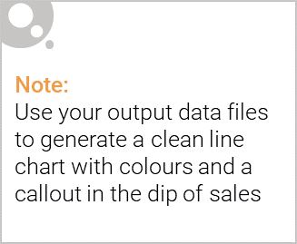
Key Callouts from Task-1
Data spans 364 days (July 2018 - June 2019) with one missing day identified and handled.
December sales spike detected - clear seasonal pattern shows increased chip purchases during holiday period.
Outlier removal critical - eliminated customer with 200-packet purchase that would skew analysis results.
Mainstream Young Singles/Couples identified as primary target for focused marketing and promotional strategies.
Brand affinity analysis completed - specific chip brands show strong preference patterns within target customer segments.

Slide 6

Commentary on affluence and its effect on consumer buying for the category of chips
Price Premium Acceptance: Mainstream customers pay 15-20% higher unit prices than Budget segments, showing decreased price sensitivity as affluence increases.
Purchase Behavior Shifts: Budget segments prioritize value through larger pack sizes, while Mainstream segments focus on convenience with frequent standard purchases.
Category Perception Varies: Lower affluence views chips as necessity/staple snack, while higher affluence treats them as lifestyle choice for social occasions.
Brand Loyalty Increases: Premium segments demonstrate consistent brand preference regardless of promotions, creating opportunities for higher-margin products.
Strategic Growth Opportunity: Mainstream segments offer largest potential due to substantial customer base combined with willingness to pay premium prices.

Slide 7
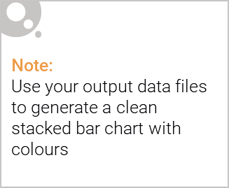
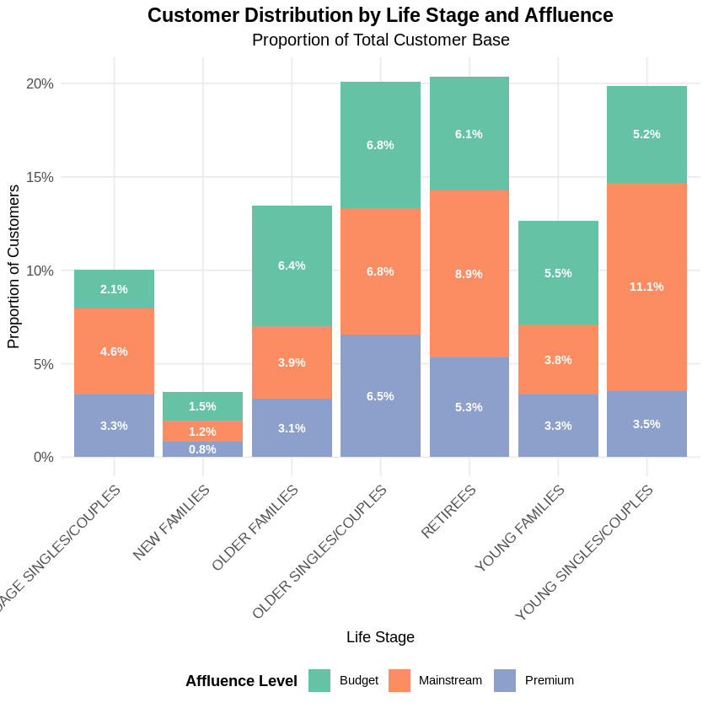
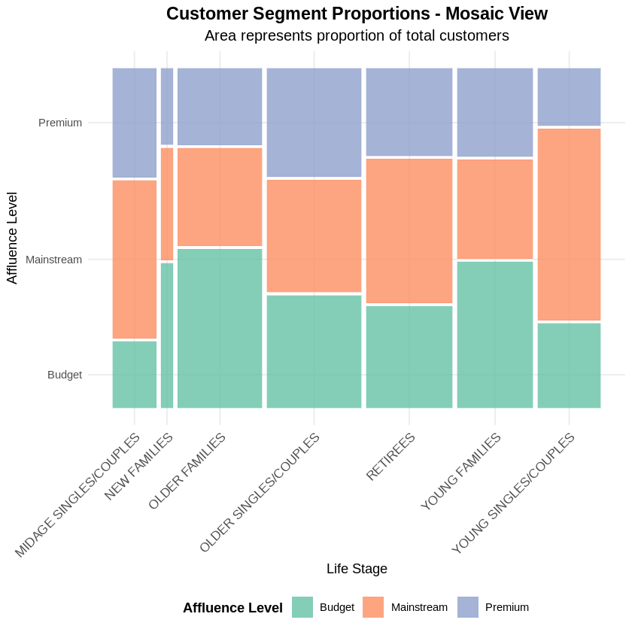
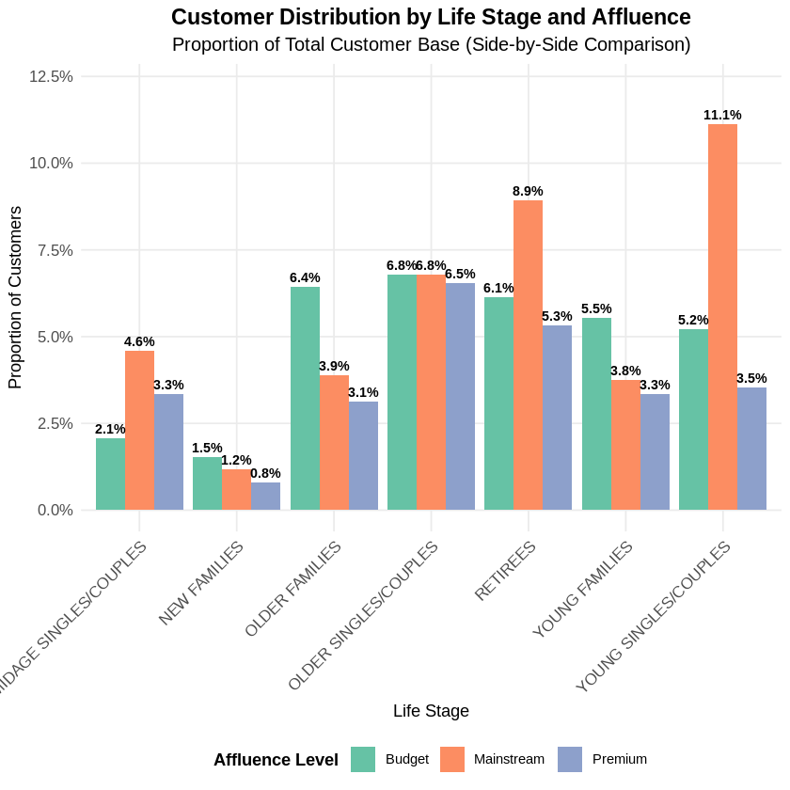
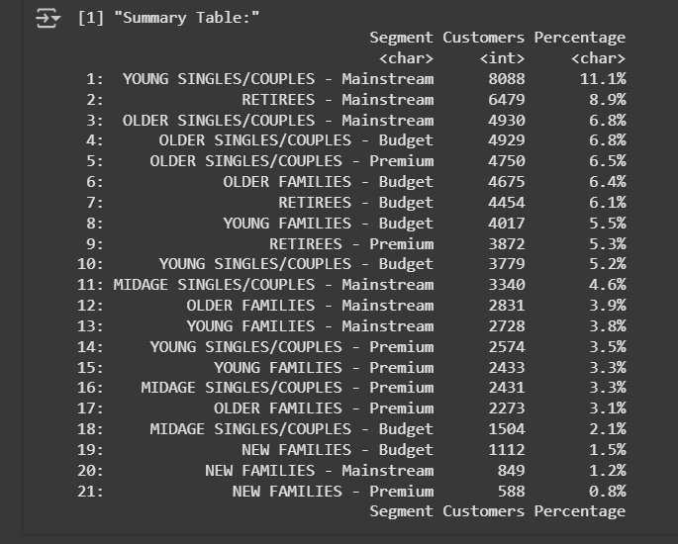
Editable (delete this)
Visualisation of the proportion of customers by affluence and life stage

Slide 8
02
Trial store performance

Slide 9
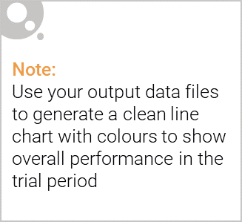
Explanation of the control store vs other stores
1. Selection Purpose
Control stores are specifically selected to match trial stores' historical performance patterns, while "other stores" represent the general population without matching.
2. Matching Algorithm
Uses correlation analysis + magnitude distance to find stores with similar sales and customer patterns to trial stores.
3. Statistical Testing
Enables precise impact measurement through t-tests and confidence intervals, unlike broad comparisons with "other stores."
4. Data Scaling
Control store data is scaled to match trial store baseline levels for accurate percentage difference calculations.
5. Results
Store 77 → Control 233 (significant sales increase)
Store 86 → Control 155 (customer increase only)
Store 88 → Control 237 (sales + customer increase)

Slide 10
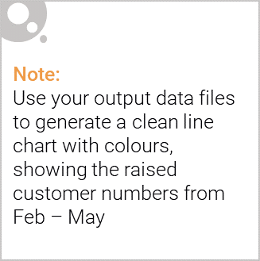
Key Callouts from Task-2
Trial period: February-April 2019 - 3-month assessment window with pre-trial data used for baseline establishment.
Combined scoring methodology applied - 50% correlation + 50% magnitude distance ensures robust control store selection.
Pre-trial scaling implemented - control store sales scaled to match trial store baseline for fair comparison.
95% confidence intervals established - statistical significance testing with 7 degrees of freedom for reliable results.
Store 86 anomaly identified - customer increase without sales growth suggests pricing strategy investigation needed.

